Slide 1
Web Technology Lecture - 13
Md. Nurul ahad tawhid
Assistant professor
Institute of information technology
University of dhaka

Slide 2
Content
Web Security

Slide 3
Security Vulnerabilities Developers Face when Creating Web Applications

Slide 4
Top Ten Security Vulnerabilities
Insecure configuration management
Denial of service
Insecure storage
Improper error handling
Injection flaws
Buffer overflows
Cross site scripting flaws
Broken authentication and session management
Broken access control
Unvalidated input

Slide 5
Insecure Configuration Management
Issues that plague the security of the site:
Unpatched security flaws in the server software
Server software flaws or misconfigurations that permit directory listing and directory traversal attacks
Unnecessary default, backup, or sample files, including scripts, applications, configuration files, and web pages
Improper file and directory permissions
Unnecessary services enabled, including content management and remote administration

Slide 6
Insecure Configuration Management
Issues that plague the security of the site:
Default accounts with their default passwords
Administrative or debugging functions that are enabled or accessible
Overly informative error messages (more details in the error handling section)
Misconfigured SSL certificates and encryption settings
Use of self-signed certificates to achieve authentication and man-in-the-middle protection
Use of default certificates
Improper authentication with external systems

Slide 7
Top attacked ports (1/1 – 6/30, 2004)
 | Port (TCP) | Service | %
1 | 80 | HTTP/Web | 30
2 | 445 | MS CIFS file sharing | 17
3 | 135 | MS DCE remote proc call | 15
4 | 4662 | E-donkey/P2P file sharing | 7
5 | 6346 | Gnutella/P2P file sharing | 5
6 | 22 | Secure shell/remote access | 4
7 | 1026 | Various dynamic services | 3
8 | 113 | Indent service | 3
9 | 2745 | Beagle | 3
10 | 1025 | Various dynamic services | 3
Source: Symantec TMS data

Slide 8
Case Study: Hacking Oracle through a Search Engine
Before launching an attack, the hacker needs to know
Where to attack
The target’s vulnerabilities
A search engine can give you both of these!
The use of search engines to attack databases appeared in Wired magazine (http://www.wired.com/news/infostructure/0,1377,57897,00.html)

Slide 9
Looking for Mr. Database
Typically, your database is behind a firewall
From Oracle’s website:
“Risk to exposure
Unless you connect the database directly to the Internet (e.g., no intervening application server or firewall), a remote buffer overflow attack via the Internet is, in Oracle’s opinion, unlikely.”
iSQLPlus is a utility supplied with the database for DBA interaction with the database
Oracle 9i introduced a web version of iSQLPlus
By default, iSQLPlus runs on Oracle’s HTTP server on port 5560 with the URL of /isqlplus

Slide 10
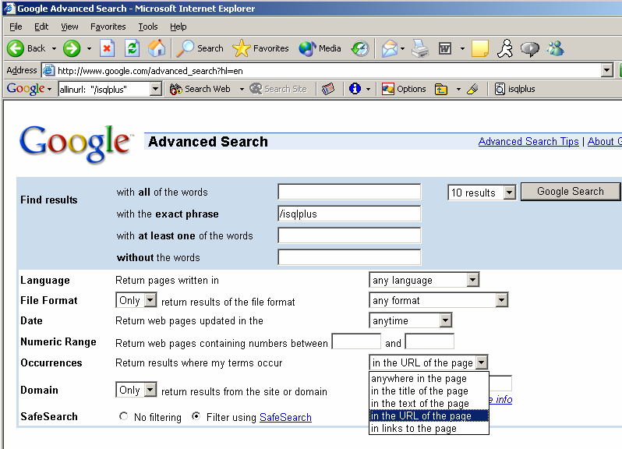
Finding a Database to Hack

Slide 11
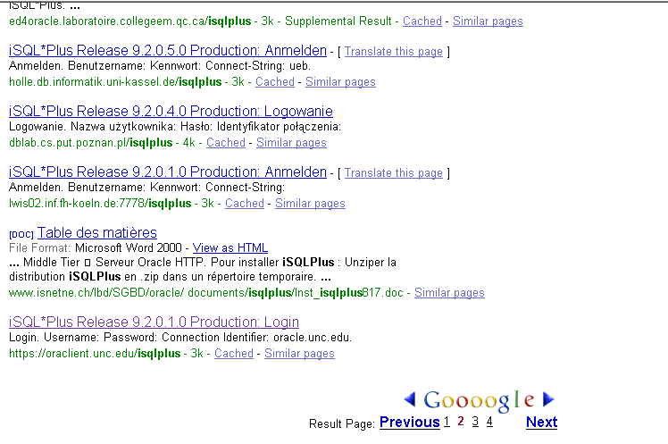
List of Sites with iSQLPlus Available

Slide 12
Logon
In this case, we’re using dbsnmp/dbsnmp (better than scott/tiger because dbsnmp is a privileged account
Survey’s indicate that 20-50% of install Oracle databases are running with at least one default username [source: Application Security, Inc.]

Slide 13
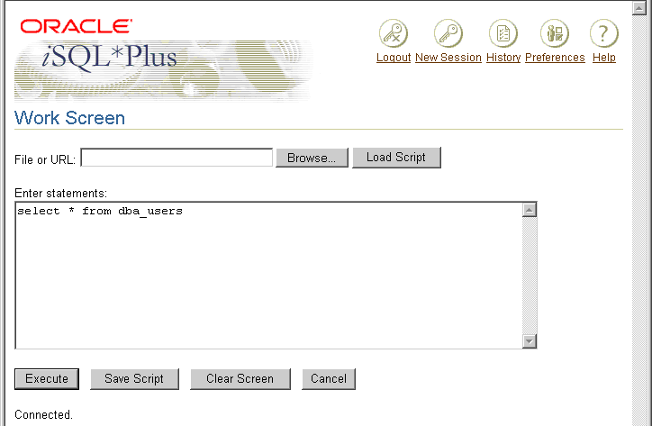
Now, Get List Of Users

Slide 14
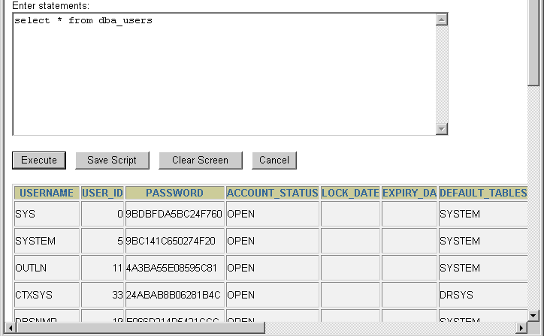
Got a List of Users

Slide 15
Lessons Learned?
Search engines reduce the need to hackers to probe victims, meaning that attacks are harder to detect
Organizations which rely solely on perimeter security are at significant risk of compromising mission critical data
Perimeter security is necessary but no longer sufficient
One security vendor estimates that 95% of security effort goes into perimeter security
How do you prevent data access?
Limit access from the external world directly to the database
look at placing additional layers of defense to lock down the data right where it sits – in the database

Slide 16
How to Protect Yourself
Create a hardening guideline for your site
Configuring all security mechanisms
Turning off all unused services
Setting up roles, permissions, and accounts, including disabling all default accounts or changing their passwords
Logging and alerts

Slide 17
How to Protect Yourself
Maintenance process:
Monitoring the latest security vulnerabilities published
Applying the latest security patches
Updating the security configuration guideline
Regular vulnerability scanning from both internal and external perspectives
Regular internal reviews of the server’s security configuration as compared to your configuration guide
Regular status reports to upper management documenting overall security posture

Slide 18
Denial of Service
When an attacker generates so many requests, it swamps a web application or some aspect of it (like database connection pools)
Hard to determine what is a legitimate DOS (or DDOS)
Multiple users hitting the site simultaneously?
Multiple users hitting “Reload” because of a previous problem?
Have you been “Slashdotted”?

Slide 19
Other Forms of DOS
An attacker can lock out a legitimate user by sending invalid credentials
Attacker can request a new password for a user

Slide 20
How to Protect Yourself
Protecting against DOS attacks is difficult
Limit resources allocated to any user to a bare minimum
For authenticated users, establish quotas
Consider only handling 1 request per user at a time by synchronizing the user’s session
Consider dropping any requests you are handling for a user if another request from the same user appears

Slide 21
How to Protect Yourself
For unauthenticated users
Avoid unnecessary access to database or other expensive resources
Consider caching the content received by unauthenticated users instead of generating it
Make sure that your error handling is robust

Slide 22
Insecure Storage
Most applications need to store information
Common mistake areas:
Failure to encrypt critical data
Insecure storage of keys, certificates, and passwords
Improper storage of secrets in memory
Poor sources of randomness
Poor choice of algorithm
Attempting to invent a new encryption algorithm
Failure to include support for encryption key changes and other required maintenance procedures

Slide 23
How to Protect Yourself
The easiest way is to not store information!
Rather than encrypting credit cards, make users re-enter them
Instead of storing encrypted passwords, use a one-way hashing function (like SHA-1)
Don’t invent your own cryptography

Slide 24
How to Protect Yourself
Make sure that secrets (keys, certificates, passwords) are securely stored
The master secret should be stored in 2 locations and reassembled at run-time
Email addresses
Spiders crawl websites, looking for passwords
http://automaticlabs.com/products/enkoderform/
Encodes email addresses as a complex looking JavaScript function
Works as before, but spiders can’t harvest the address
What’s the only problem with this solution?

Slide 25
Improper Error Handling
Don’t show detailed internal error messages to the rest of the world
Stack traces
Database dumps
Error codes
Inconsistent error message also reveal information
“File not found” vs. “Access denied”

Slide 26
How to Protect Yourself
Gracefully handle all errors
Don’t reveal any internal details
Log most errors

Slide 27
Injection Flaws
Allow attackers to relay malicious code through the web application to another system
OS calls
External programs through shell commands
Calls to SQL (SQL Injection)
Vulnerable any time a web application uses an interpreter of any kind

Slide 28
SQL Injections
Attacker must find a parameter that the web application passes through to the database
Example
Consider this SQL String
SELECT * FROM USERS where Username = ‘user name input’ and Password = ‘password input’
With no input validation, the user can enter
User name input’ --
Or
Password input’ OR 1 = 1 --

Slide 29
SQL Injection
Because a semi-colon separates commands, attackers can supply values with semi-colon delimited attack code
User input; drop table users;
To exploit SQL Injection, the attacker must find a parameter
These attacks generally just take patience
Range from trivial to extremely severe

Slide 30
How to Protect Yourself
Carefully validate the data
Use Stinger or custom scrubbing routines
Use stored procedures or prepared statements
Make sure that the web application only has the privileges it needs
If you need to pass user input to an external program
Scrub the input
Check for and log error conditions, return codes, etc.

Slide 31
Buffer Overflows
Attackers corrupt the execution stack of a web application
Overrun a buffer (i.e., a String)
Reset the pointer to the function return address to point to attacker code
Generally, attacker has complete (root) access to the system
Exists for any native executable language
Not possible in J2EE applications (except for the JVM itself)
Difficult in .NET web applications

Slide 32
Cross-site Scripting Flaws
Occurs when an attacker uses a web application to send malicious code (usually a script) to another user
Two categories
Stored
Injected code is permanently stored on the target server (database, message forum, visitor list, etc).
Reflected
Injected code is reflected off a web server, in an error message, search result, etc.
Reflected attacks are delivered via another route (email message, another web server)
User clicks on email message, code is reflected back to the user’s browser, executes the script

Slide 33
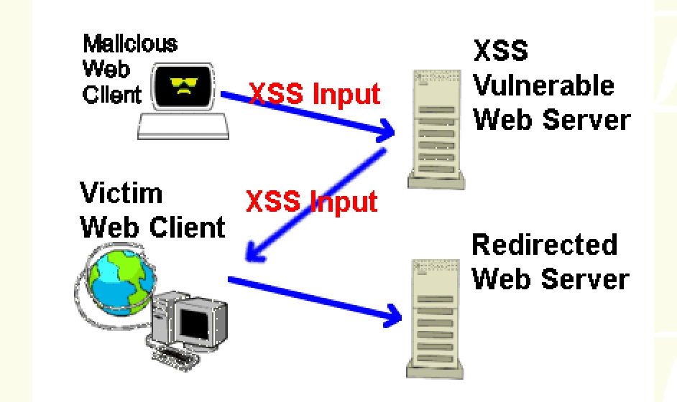
XSS Vulnerabilities

Slide 34
XSS Vulnerabilities
Even brochureware sites are vulnerable
Simple error pages for 404 or 500 may show the contents of the URL requested
Makes them vulnerable to reflected attacks
A huge number of documented XSS techniques
Clever hackers use Unicode instead of “<>” tags
Some attacks don’t even require “<>” tags
If the attacker can make your site display a chunk of HTML
Both IMG and IFRAME tags allow a new URL to load when the HTML is displayed
The BadTrans worm used this technique to propagate itself using Outlook Express and Outlook’s “execute on view” feature

Slide 35
XSS Scenarios: Scripting via a Malicious Link
The attacker sends an email to the victim
<A HREF=http://legitimateSite.com/registration.cgi?
clientprofile=<SCRIPT>malicious code</SCRIPT>>
Click here</A>
When an unsuspecting user clicks on this link, the URL is sent to legitimateSite.com including the malicious code
If the legitimate server sends a page back to the user including the value of clientprofile, the malicious code will be executed on the client Web browser

Slide 36
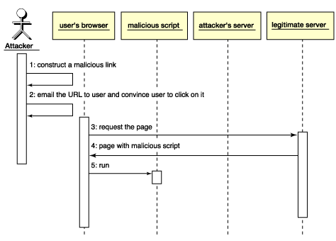
XSS Scenarios: Scripting via a Malicious Link

Slide 37
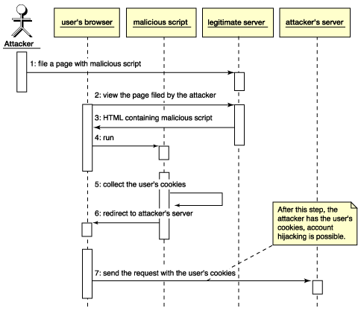
XSS Scenarios: Stealing Cookies

Slide 38
XSS Consequences
Range from annoyances to complete control
Disclosure of a user’s session cookie
Disclosure of end user files
Installation of Trojan horse programs
Redirecting to another site
Modifying content

Slide 39
How to Protect Yourself
Validate
Headers
Cookies
Query strings
Form fields
Hidden fields

Slide 40
Broken Authentication & Session Management
Includes all aspects of handling user authentication and managing active sessions
Particularly vulnerable are “Forgot my password”, “Password change”, etc.
Subject to “walk by” attacks
Should always be re-authenticated for those functions

Slide 41
How to Protect Yourself
Create strong passwords
Log repeated failed login attempts
Restrict to a certain number of attempts per unit of time
Don’t record the password (failed or otherwise) in the log
Don’t indicate to the user whether the user name or password was invalid
Users should be informed of the time of the last successful login and number of failed attempts

Slide 42
How to Protect Yourself
Password change controls
Always require old and new passwords
If forgotten passwords are emailed, the system must force use to reauthenticate whenever the user changes their email address
Otherwise, a “walk by” attack is possible
Password storage
Passwords should always be hashed or encrypted when stored (no matter what the storage)
Hashing is better because it isn’t reversible

Slide 43
How to Protect Yourself
Protect credentials in transit
The only effective solution is to use SSL
Session ID protection
Ideally, a user’s entire session should be protected via SSL
Session ID can’t be grabbed off the network
If you can’t use SSL
Don’t include session ID’s in URLs or referrer header
Session ID’s should be changed when switching to and from SSL

Slide 44
How to Protect Yourself
Browser caching
Authentication and session ID should always be submitted via Post
Authentication pages must be marked with all varieties of the no-cache tag
Some browsers support autocomplete=false flag to prevent storage in autocomplete caches

Slide 45
Broken Access Control
Access control (and authorization) covers how a web application grants access to content
Many sites access control isn’t centrally located
Grown over time
Ad hoc rules scattered in hidden corners
Remote administration is a particular problem

Slide 46
How to Protect Yourself
Code that implements access control must be audited
Should be centralized
Well structured
Modular
Find out how website is administered
By developers, web designers, network staff

Slide 47
How to Protect Yourself
Build a web application security policy
What types of users can access the system
What functions and content each user can see
Specific issues
Insecure ID’s
Forced browsing past access control checks
Path traversal
File permissions
Client-side caching

Slide 48
Unvalidated Input
Attackers can tamper with:
URL
Query string
Headers
Cookies
Form fields
Hidden fields
Tools exist that bypass browsers
Telnet
Achilles

Slide 49
Common Attacks
Forced browsing past access control checks
Command insertion
Cross site scripting
Buffer overflows
Format string attacks
SQL injection
Cookie poisoning
Hidden field manipulation

Slide 50
How to Protect Yourself
Parameters validated against a positive specification
Data type (string, integer, real, etc…)
Allowed character set
Minimum and maximum length
Whether null is allowed
Whether the parameter is required or not
Whether duplicates are allowed
Numeric range
Specific legal values (enumeration)
Specific patterns (regular expressions)

Slide 51
Positive vs. Negative Filtering
Positive filtering implies a set of rules for valid input
Negative filtering tries to filter out bad data
Negative filters cannot be comprehensive enough
Filtering out bad data is doomed to failure

Slide 52
Summary
Be careful out there!
Some of these problems are automatically handled by J2EE
Be diligent on your security
It pays to be paranoid
Take advantage of tools and frameworks
Don’t think it can’t happen to you

Slide 53
End

